Slide 1
Life in the Games Industry
Jonathan Young
Trinity Western University
March 15, 2011

Slide 2
VIDEO GAME INDUSTRY OVERVIEW Ubisoft
1986 The five brothers of the Guillemot family found Ubisoft as a computer game publisher in France (Brittany)
1994 Opens a studio in Paris, France (now HQs)
1996 Becomes a publicly traded company & continues to expand globally
2009 Now has 24 Production Studios in 17 countries (4 alone are in Canada)
Employs over 6,000 people worldwide (including offices in 28 countries)
2008-09 Ubisoft at a glance:
€ 1.058 billion Sales
€ 150 million Net Income
€ 265 million R&D Investments
*19 multimillion unit-selling brands
3rd Independent Publisher Worldwide

Slide 3


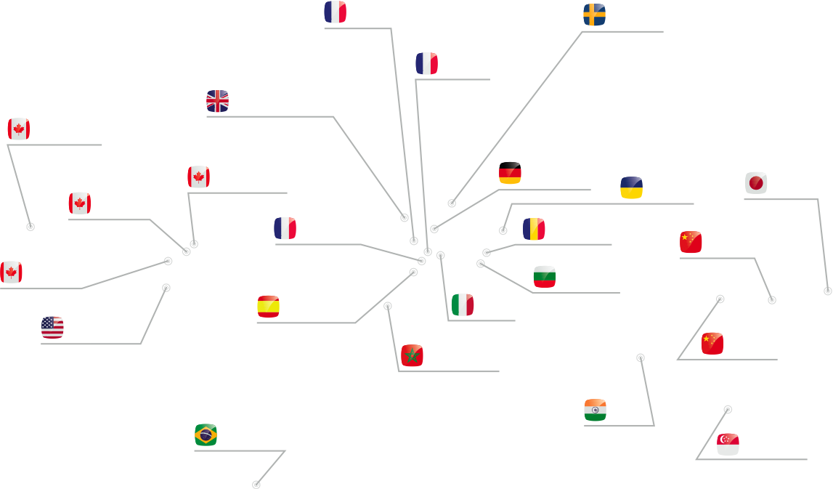



Game distribution in more than 55 countries
24 production studios in 17 countries
20 business offices
Global presence

Slide 4
VIDEO GAME INDUSTRY OVERVIEW Local Vancouver Industry
Over the past 5 years the industry had grown 150%
Was recognized as a Global HUB
Peaked at over 4,000 employees and over 60 interactive studios
Since autumn of 2008, the industry has lost 26% of its workforce
Other jurisdictions gained product development & our talent
(high-value jobs)

Slide 5
VIDEO GAME INDUSTRY OVERVIEW A Future Industry
Industry has only entered 3rd decade
Current global $51 billion market as measured by retail sales in 2008
Expected to expand to $87 billion by 2014 (PwC Global Ent & Media Outlook 2010-2014)
PwC determined that the video game industry is the fastest-growing entertainment sector, growing at an annual compound rate of 10.6%
(more than double the filmed entertainment sector and nearly double the growth of TV)
Sustainable, green knowledge-based technology jobs

Slide 6
Life in the Games Industry About Me
Career History:
Ubisoft Vancouver/Action Pants 2008-Present
Electronic Arts Canada 2006-2008
NGRAIN Corporation 2001-2005
Ministry History:
Small Group Leader 2005-Present
Teens Camp Counsellor 2006-Present
Sunday School Teacher 2009-Present
…has it been that long?

Slide 7
Introduction
These are my opinions.
Others may disagree.
My opinions are subjective! However, my hope is you will find them useful.
Ceteris paribus - "all other things being equal"

Slide 8
Setting Priorities Planning for the future
Where do you want to be in 10 years?
One day you will be old- like me!
Enjoy school while you have the chance. But remember- serious choices lie ahead!

Slide 9
Big Lessons from School Skipping to the “Last Lectures”
Less about what you learn -> more about "How to Learn" or, "How to Work Hard"
"The more knowledge you have the more you realize all that you don't know"
80/20 rule: You will only use 20% of what you learn, but you don't know what 20%, so you have to learn 100%
Gain the ability to put knowledge "on the shelf" and recall what you need for later
-moving knowledge from the "passive set" to the "active set"

Slide 10
Working With Others
-be reliable "Show Up On Time"
-do quality work "Don't cut corners"
-keep your word "Finish on schedule"
-be easy to work with "Be humble and consider others better than yourself"
-"Do I want to work with this person?“ > Ability
-Unpleasantness trumps ability- especially if you are starting out and do not have a reputation
Does it sound easy? Not everyone is like this!

Slide 11
How to Get Hired (anywhere not just in the Games Industry)
-apply with humility: it helps!
You may accept a job in a lower than ideal starting position with the expectation of moving up over time
-tough market: apply to low positions to start!
-the best position to apply for jobs from, is with one
-make friends, since most available jobs are filled by friends' referrals!

Slide 12
The Technical Interview Congratulations for making it this far!
You will probably be asked about things from the reviewer's experience.
It is important to study:
Guess what will be asked beforehand and study it.
Know something about the company, enough to ask interesting questions about it. Guess on what their processes are.
Guess what their main challenges are. How to fix their problems? Offer your own solutions.
It is important to get every question right!
If you cannot answer the question, get vocal and talk your way through it.
Often the technical reviewer is ill prepared or tired:
- so use your preparedness to put him/her at ease!
- use the opportunity to sell yourself!

Slide 13
A Day In the Life Of
arrive at work 10am
20% coding
20% thinking/organization
long lunch
20% outright waiting for build, fixing glitches or other delay
40% debugging
go home ~6:30pm
20% coding is a high estimate!

Slide 14
For Your Reference: An Easy Project NHL ‘09
Crack Team
Working from established code base
Known release cycle
Clean and efficient code
Enthusiastic team (Canadian city works best!)
Personal interest in the subject!

Slide 15
For Your Reference: A Hard Project Sims 2 Pets
delayed by 130+ days
missed simultaneous ship date with other consoles!
over-ambitious project at the start
AND more features added throughout
a bad sign: experienced developers refused to participate in project at start.
designers not sure about game mechanics until late in development cycle
working with a remote studio (Redwood shores, CA)
Task involved integrating and porting work to portable platform (PSP)
remote studio finishing work at last moment before deadline
remote studio changing a lot of already-integrated work at each integration
integrated code itself was buggy

Slide 16
For Your Reference: A Hard Project Sims 2 Pets (continued)
porting from a more powerful system to a less powerful one, with less memory
load time optimizations required for disc format!
tools reliant on binary format (non-mergeable), must be rebuilt by expensive process
2-4 hour build time (with assets!)
Tools would fail silently
Office move in middle of development
Developers at remote site did not get along, 3 of the major tools did not share code because the developers didn't want to talk to each other
Most of the Team still working at midnight-> low productivity!
"We're going to need you to come in this weekend"

Slide 17
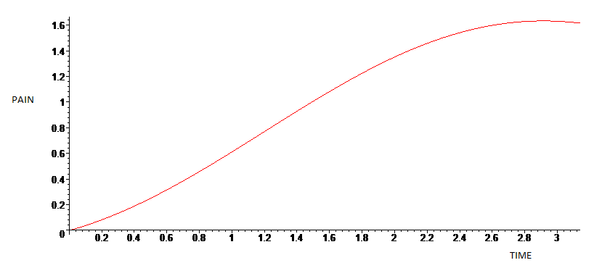
Pain vs. Time Graph What to expect
Typical project run through:

Slide 18
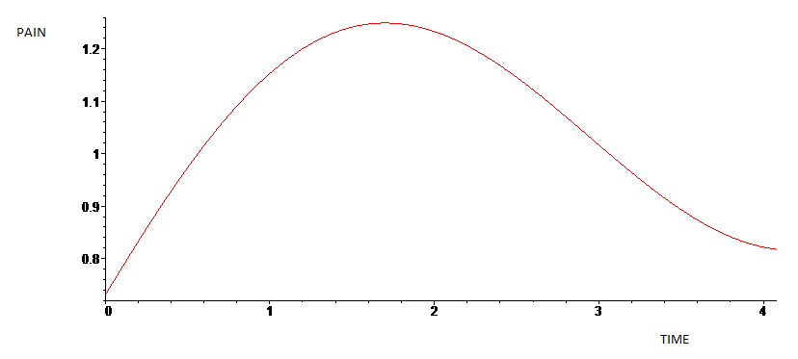
Pain vs. Time Graph Better?
More of what we desire:

Slide 19
Pain vs. Time Graph Truly enlightened planning
Save time at the end for:
-thorough debugging
-implementation unexpectedly hard
-great feature ideas that only become apparent when product is almost done
Tuning a nearly finished game can turn a bad game into good
Games that are bad throughout the design cycle can get better at the last moment!
-Crackdown
-European Air War

Slide 20
The Downside of Working in Video Games ☹
-some tasks can be VERY hard and require a lot of time and energy (even at home)
-moral issues with game content!
-volatile job market
-sales are easy to project, hard to get right!

Slide 21
The Benefits of Working in Video Games ☺
-when trust is earned, people stop watching the clock: doctors appointment, talks, etc. are ok
-generally speaking, hours are flexible
-you will find pay is better than average
-interesting people to work with. most will have interesting hobbies: outdoors, music, arts, ministry!

Slide 22
Living Out Faith in the Workplace
Work for the Lord
-do your assigned hours
-show humility in the workplace
-treat people well regardless of what they can do for you in return
Make Church a priority over work
You are not alone: Downtown Vancouver is a hub of Christian activity.
Seek out Christian Co-Workers, my hope is, you will find ☺

Slide 23
Personality Conflicts At Work: A Christian Perspective
Can swing from being a non-issue to a major issue unexpectedly!
some bad apples are in every organization
For some, “getting ahead and climbing the corporate ladder” is the meaning of life. Really!
-no easy answers: treat others as well as you can but in cases of abuse it may be most helpful to leave.
Rejoice and be glad, for in the same way they persecuted the prophets who were before you.

Slide 24
For Your Reference: Difficult Coworkers
-Asperger syndrome
-see being cooperative as a sign of weakness
-political
-untrustworthy, yet are in positions of power
Focus on things other than making a great product:
-looking as good as possible while doing the least amount of work possible, to the detriment of the project
-information hiders/brokers

Slide 25
For Your Reference: Great Coworkers
-admit when they don't know something
-will work with you through the "critical time"
-friendly people are always easier to work with
-have time to work on a technology that you don't understand!
Be slow to anger and quick to forgive!

Slide 26
When to Leave Your Job
Are you unhappy? Know that you can “Promote yourself!”
-moving away from abusive management
-are you busy at work? if not, it's a bad sign, start looking.
God is calling you to move?
Rule of Thumb: after 2 years it is generally viewed as quite reasonable to move on, especially if you are unhappy.

Slide 27
Setting Priorities Conclusion
The End of Life Test
In the long run we cannot keep title, wealth or possessions
It makes a lot of sense to prioritize relationships over making money.
-Especially when you get older? good relationships are actually worth far more than $$$
It's not too late to change paths now!
Everything is a blessing. Don't take life for granted- enjoy every day.
Watch for acting out of jealousy or fear; you will almost always regret

Slide 28
Setting Priorities Conclusion
Remember everyone is watching your behaviour, whether they now you are a believer now, or find out later.
-So live with character!
When it comes to evangelism, Lifestyle > Words
Real faith is tested when it costs you something!
Don't be a lone wolf: help from others makes life MUCH easier
Your church needs you! Stand up and be accountable for the future of your community.
Volunteering in ministry is a great way to grow your soft skills and grow in your walk with God.

Slide 29
Life in the Games Industry Q & A
Questions? Answers?

